Slide 1
Introduction to RL
Pre-notebook
Math and intuition

Slide 2
What The heck is RL ?🤔
It is about learning the optimal behavior in an environment to obtain maximum reward and you keep doing this until someone tells you to stop. 😐

Slide 3


Slide 4
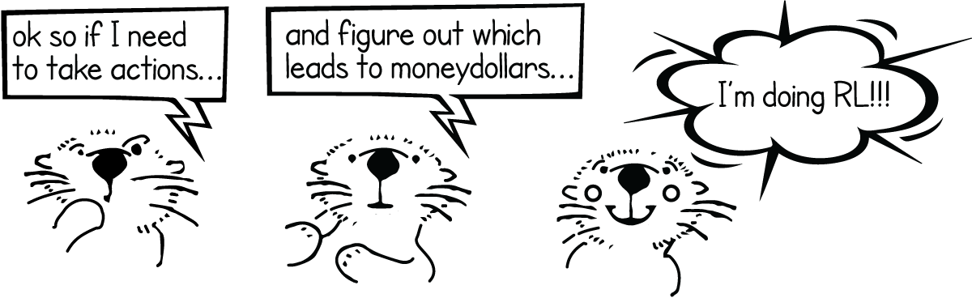

Slide 5

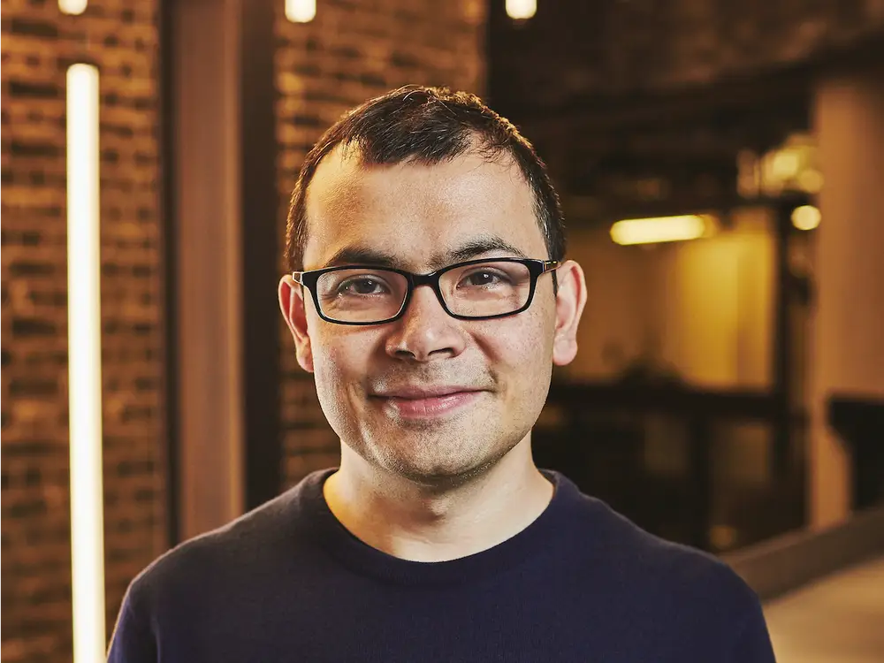
Modern RL = Deep RL [DQNN - 2015]
1960
DL+ RL

Slide 6




Applications
Robotics : Berkeley Robotics labs , humanoid
GamePlay : Atari , DoTA , GO
Trading systems : TwoSigma

Slide 7

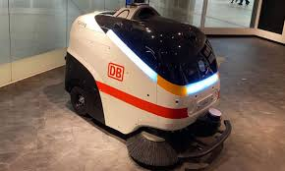

Problem Fourmaltion
Agent :
Enviroment :
States : L 1 - L 24
Actions :
Rewards : R(s , a)
Walls :
 | 2 | 3 | 4 | 5 | 6
7 | 8 | 9 | 10 | 11 | 12
13 | 14 | 15 | 16 | 17 | 18
19 | 20 | 21 | 22 | 23 | 24

Slide 8

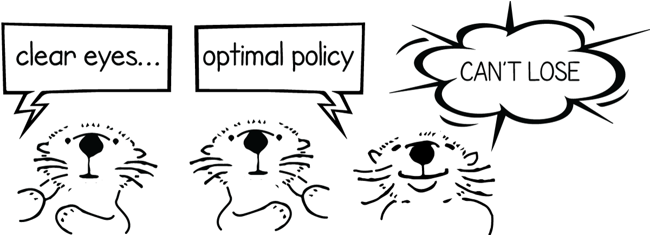
Policy 𝝅

Slide 9







Value-function : V(s)
which is the value of every state in the world ?
 | 2 | 3 | 4 | 5 | 6
7 | 8 | 9 | 10 | 11 | 12
13 | 14 | 15 | 16 | 17 | 18
19 | 20 | 21 | 22 | 23 | 24

Slide 10
State-value Vs Action-Value
The state-value function basically says “where you are in the world is important, so figure out the sequence of good states and follow that”.
The action-value function says “we’re in a state, and some of the actions we can take are awesome, and some are terribad, figure out the awesome ones”.

Slide 11
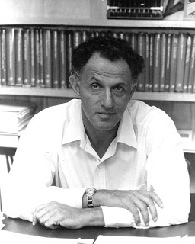
Father of DP
Bellman Backup
Richard E. Bellman

Slide 12
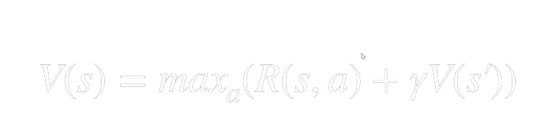
S
Bellman equation
Discounting factor
0 ≤ Discounting factor ≤ 1

Slide 13

Immediate reward
[a , a , a , a , a]
future reward
n
k
in esscne finding best A that maximize the R and V

Slide 14
0.729 1 | 0.81 2 | 0.9 3
0.81 4 | 0.9 5 | 1 6
0.9 7 | 1 8 | 1.11 9
Let assume :
s
R(s,a) = 0
A

Slide 15
Dynamic Programming And RL
Recursion
Overlapping sub-problems
0.729 1 | 0.81 2 | 0.9 3
0.81 4 | 0.9 5 | 1 6
0.9 7 | 1 8 | 1.11 9
Why it is not Trivial ? 🤔

Slide 16
Src
1
2
3
6
4
5
7
8
9

Slide 17


Markov decision Process (stochastic)
1 | 2 | 3
4 | 5 | 6
7 | 8 | 9
0.05
0.05
0.9

Slide 18

adding
resulting

Slide 19
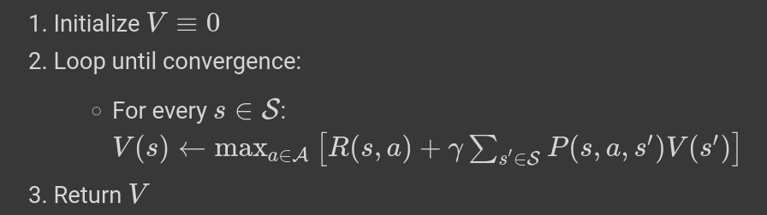
The algorithm

Slide 20



Q-function
the value of all of the actions, from all of the states

Slide 21


Intution

Slide 22
a3
Let s = 1
a1
a2
a4
aK
s1
S2
Q :
S3
Q(s,a1)
Q(s,a2)
Q(s,a3)
S4
Sn

Slide 23
Policy Iteration steps over Q function
Initialize your Q function randomly (so the value of any action from any state is a random number). Start in a random state (call it S).
Do epsilon-greedy
update The Q function for the state we were in, and the action we took ( precisely : if this action was a good action, then the state that we ended up in should be a better state than the one we were currently in (closer to the goal). If we got a bad reward, then we reduce the value of Q(S,A) .
Repeat Steps until you end up in a goal state. Once you do go back to Step 1 and start in a new random state

Slide 24
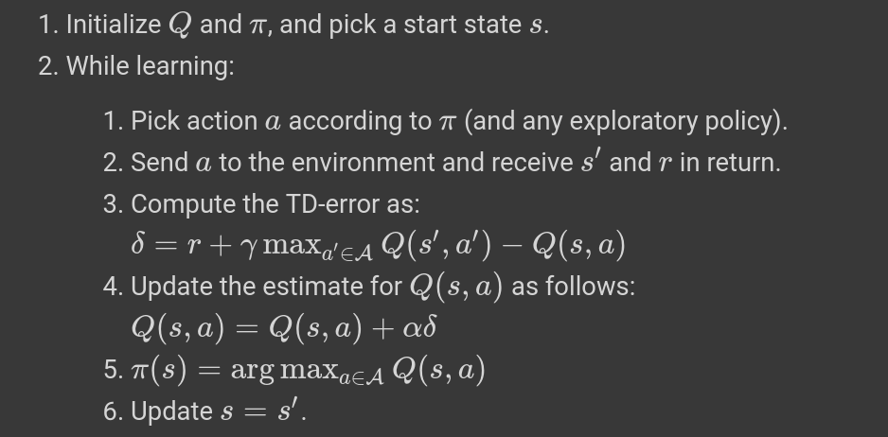
Q Learning Algorithm

Slide 25

Temporal Difference : TD(s,a)
s
s
Q(s, )
Q(s, )
Q(s, )
Time : T
Time : T-1
Q(s, )
Q(s, )
Q(s, )

Slide 26
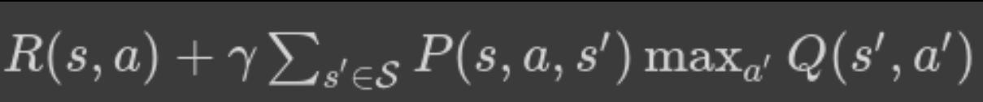
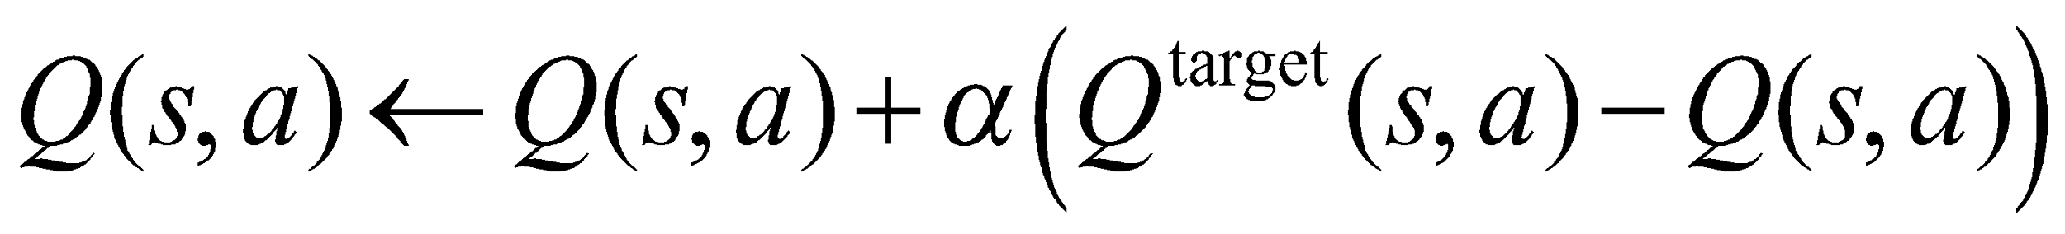
Qt-1(s, a)
VS Qt(s, a)
Qt-1(s, a)

Slide 27

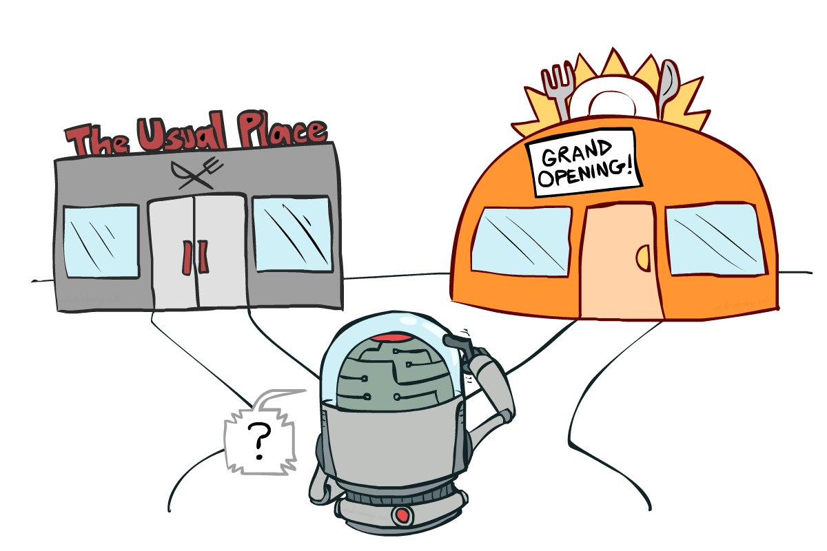
Exploration/Exploitation trade off
Exploration is finding more information about the environment.
Exploitation is exploiting known information to maximize the reward.

Slide 28
Exploration strategies
Idea: explore more in the beginning, become more and more greedy over time
ε-greedy: with probability 1–ε, follow the greedy policy, with probability ε, take random action
Demo

Slide 29
Deep-Q Learning
States in Atari Games
Q(s,a) : Table
DNN
s
Q(s,a1)
Q(s,a2)
Q(s,a3)
Q(s,aK)

Slide 30
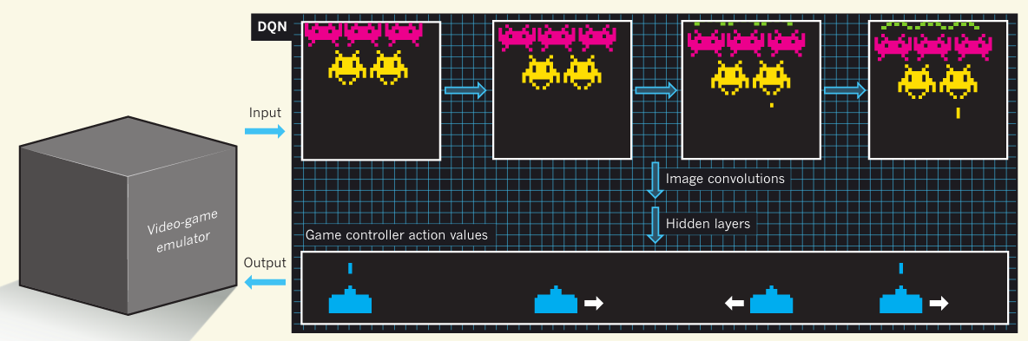
1 | . | . | . | . | . | . | . | . | i | . | . | . | . | . | . | . | . | . | k
Q(s, Ai )

Slide 31

Why we can not input A and s 🤔 ?
A
DNN
Q(s,a)
s
Insufficient

Slide 32
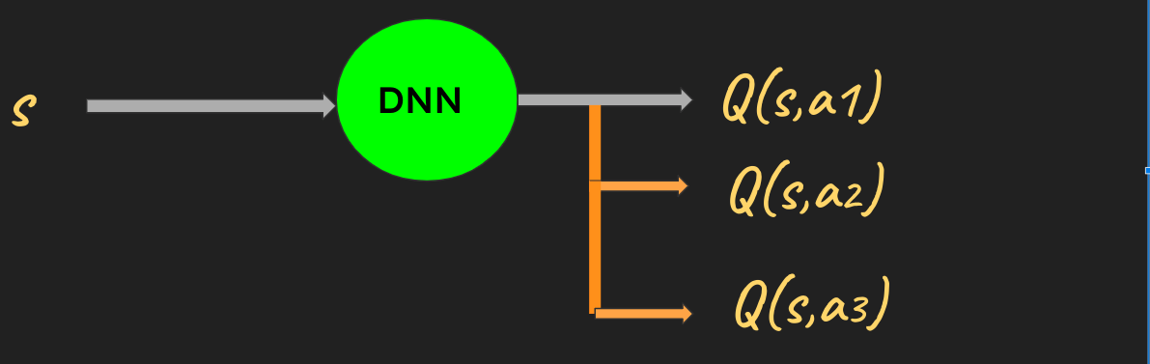
Q(s,a)
V(s)
Q(s,a,𝞗)
NExt state (Policy)

Slide 33

Yaaay we have done the hard lift , let us go to the notebook

